Slide 1
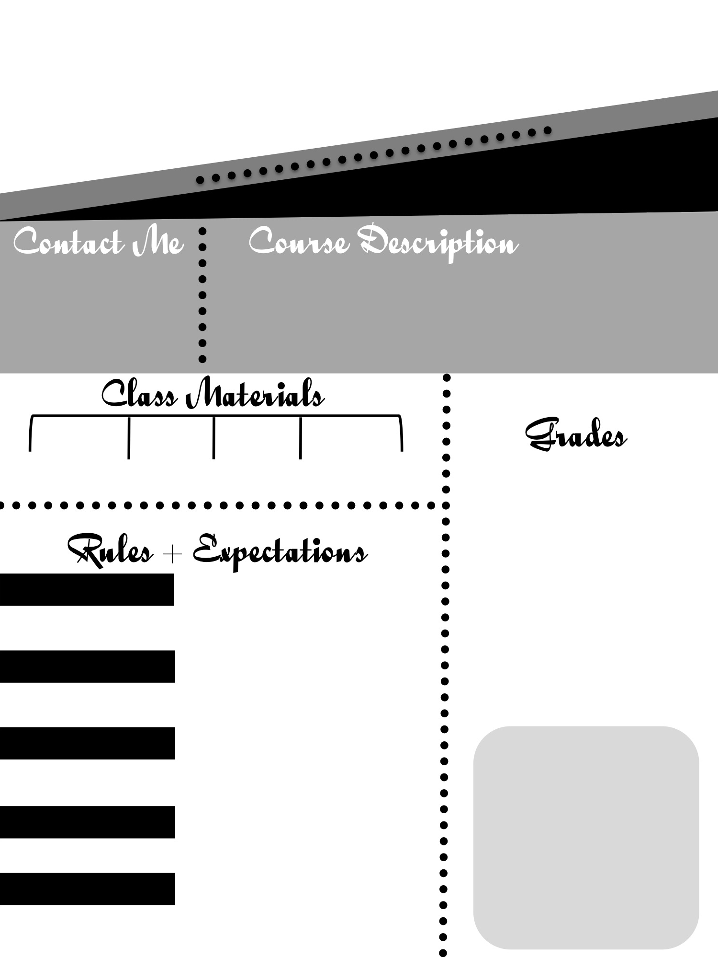
Genre Exploration
& Creative Writing
Mrs. Wolfley
2017-2018
Mrs. Wolfley
Wolfley_hl@mtnhomesd.org
http://wolfleyhl.mtnhomesd.org
My goal with this class is to give your child the opportunity to explore and interact with literature that they are usually not exposed to at school, have more say in what they read, and have fun playing with language through the creative writing process. It’s my desire that each of my students develops a more positive relationship with the written word.
Pen or pencil
Creativity
Composition Notebook
Students will be graded on class participation, note checks, reading logs, and various performance tasks. Late work for any reason other than an excused absence will be accepted with an automatic reduced percentage. Late work due to an absence is due no later than two days after a return to school. All missing work is the student’s responsibility.
Rule 1
Come to class prepared to learn and be in your seat when the bell rings..
Rule 2
Keep your phone and headphones out of sight and silenced unless given permission to use them.
Rule 3
.
Keep your hands to yourself at all times.
Rule 4
Listen respectfully when others are speaking or reading.
Rule 5
Respect others at all times.

Slide 2
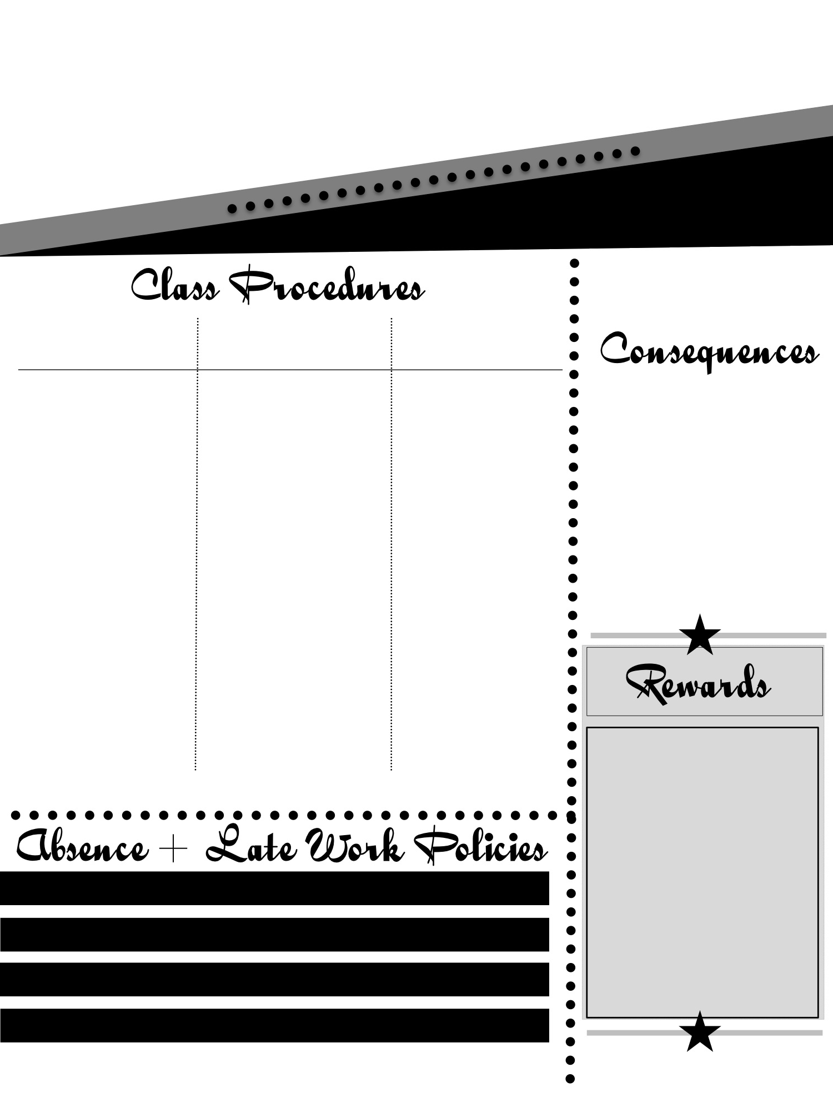
Genre Exploration
& Creative Writing
Mrs. Wolfley
2017-2018
Course Content
Movies
Suggested Supplies
Your child will be exposed to various texts from a variety of literary genres throughout the school year. We will be reading several short stories, speeches, and poems along with novels chosen from the following list:
*The Outsiders
*Monster
*Flowers for Algernon
*Anne Frank: The Diary of a Young Girl
*King of the Mild Frontier
*The Princess Bride
.
We will also watch various films throughout the year, time permitting. These are intended to support their experience of the literature. Some possibilities include:
*The Outsiders
*Charlie
*The Devil’s Arithmetic
*Anne Frank
*How the Grinch Stole Christmas
*The Princess Bride
I expect each student to bring a book to class everyday. There are no exceptions, as I provide time in class for them to read something of their own choosing and I expect them to make the most of it. If they forget their own book, they are allowed to choose a book from my class library. They have the option of checking the book out, if they would like to continue reading it.
If your child check s a book out, it becomes their responsibility. If they cannot find it, they will be responsible for replacing it, or bringing in the amount of $5 so that I can replace it.
Please sign the attached paper and let me know if you have any questions or concerns. Please feel free to contact me at any time throughout the year.
Always check my website to get missing work.
View any material that you missed that day.
.
Print work at home or check the late work bin for missed worksheets
Check with Mrs. Wolfley after school for clarification.

