Slide 1
Summarize Analyze Infer
What’s the difference?

Slide 2
Summarize
First, take a look at the picture in front of you. What do you see? Just write down the “Who, the what, and the where”. Include details, but not your opinion. (You can tell me that the picture involves two children, but don’t tell me they are “cute”. This is your opinion).

Slide 3
Background Knowledge
Maybe there are puzzle pieces in your pictures. Do you already know how puzzles work? Include that here. Maybe it’s a picture of a classroom. You already know what that is for. Include that here.

Slide 4
Infer
Now, try to tell me what else you think might be happening in the picture? No wild guesses. You can’t tell me that the two children are spies from anther planet, because there is no evidence for that in your background knowledge or summary.

Slide 5
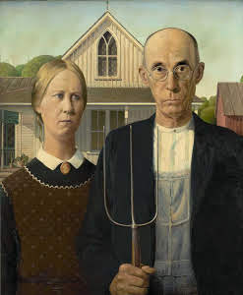
Analyze
Now, let’s practice analyzing. This is a
Fairly famous painting titled “American Gothic”.
*1-Summarize what you see in this picture.
*2- What do you know about farmers? About this time period?
*3 What can you guess about what is happening in the picture?
*4- Now, use all of this knowledge to tell me what the writer is trying to tell us with his painting.

